Slide 1




Slide 2
Heroic Campaign: The Breakup week (14th of feb - 21st of feb)
Influencer Marketing:-
5-7 influencer collaboration with a minimum of 10k followers, with alternate day postings for a week till 21st feb.
We will generate a google review form to get their feedback.
We will keep offers on each day for your star dishes, so for 7 days each dish will have an offer.
With this we will proceed with the instagram ads so that we can get more engagement with the help of reels that is been created by influencer’s , with social media offer postings.

Slide 3

To Target I.C .colony :-
Offline Marketing:-
We will distribute pamphlets about Madrasi Central with the help of newspapers
With the help of this we will be able to publicise the offer that we are running in the Heroic campaign

Slide 4

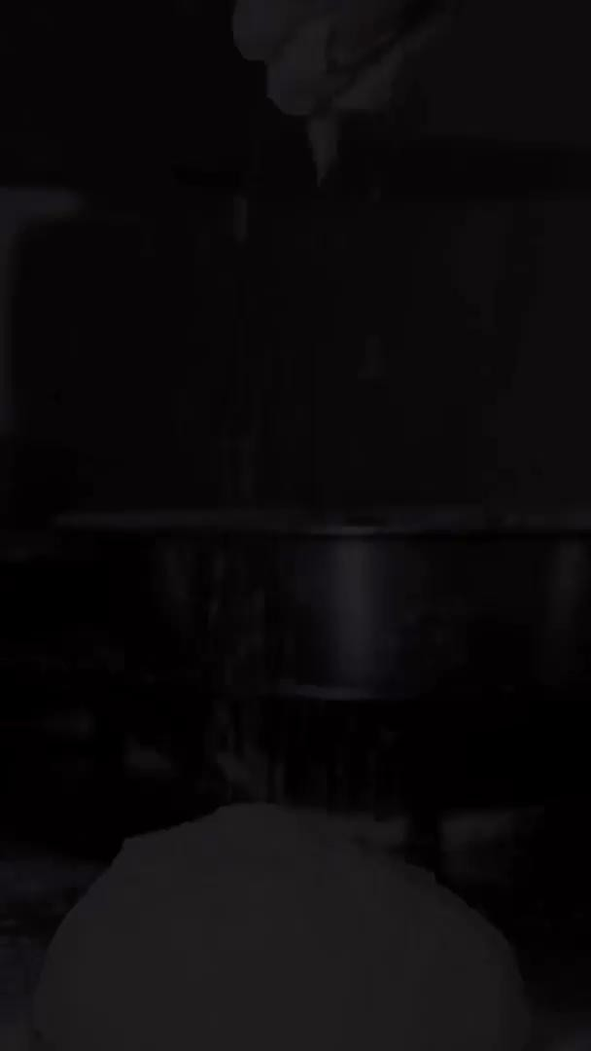
Phase 1:
Influencer Marketing(Wait for a second after clicking)
https://www.instagram.com/p/C0JvnWfN25T/
https://www.instagram.com/p/C3IN13xBVLF/

Slide 5
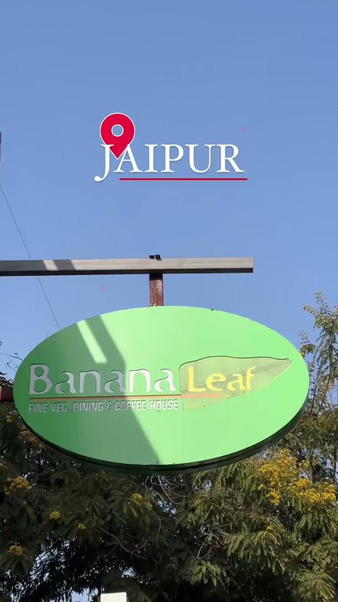
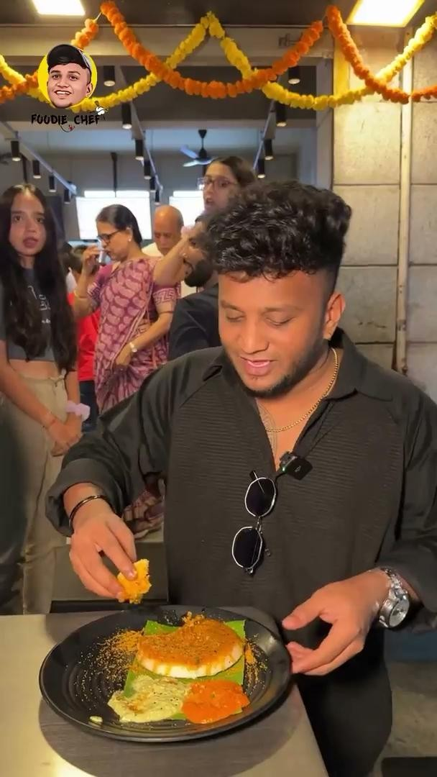

Slide 6
Types of Influencer marketing:
Barter Collaboration
Offer influencers a complimentary meal or a food tasting experience in exchange for them creating content (such as posts, stories, or videos) featuring your restaurant.
Paid Collaboration
Discuss compensation with the influencer, whether it's a flat fee, free meals, gift cards, or a combination of these. Negotiate terms that are fair and mutually beneficial for both parties.

Slide 7
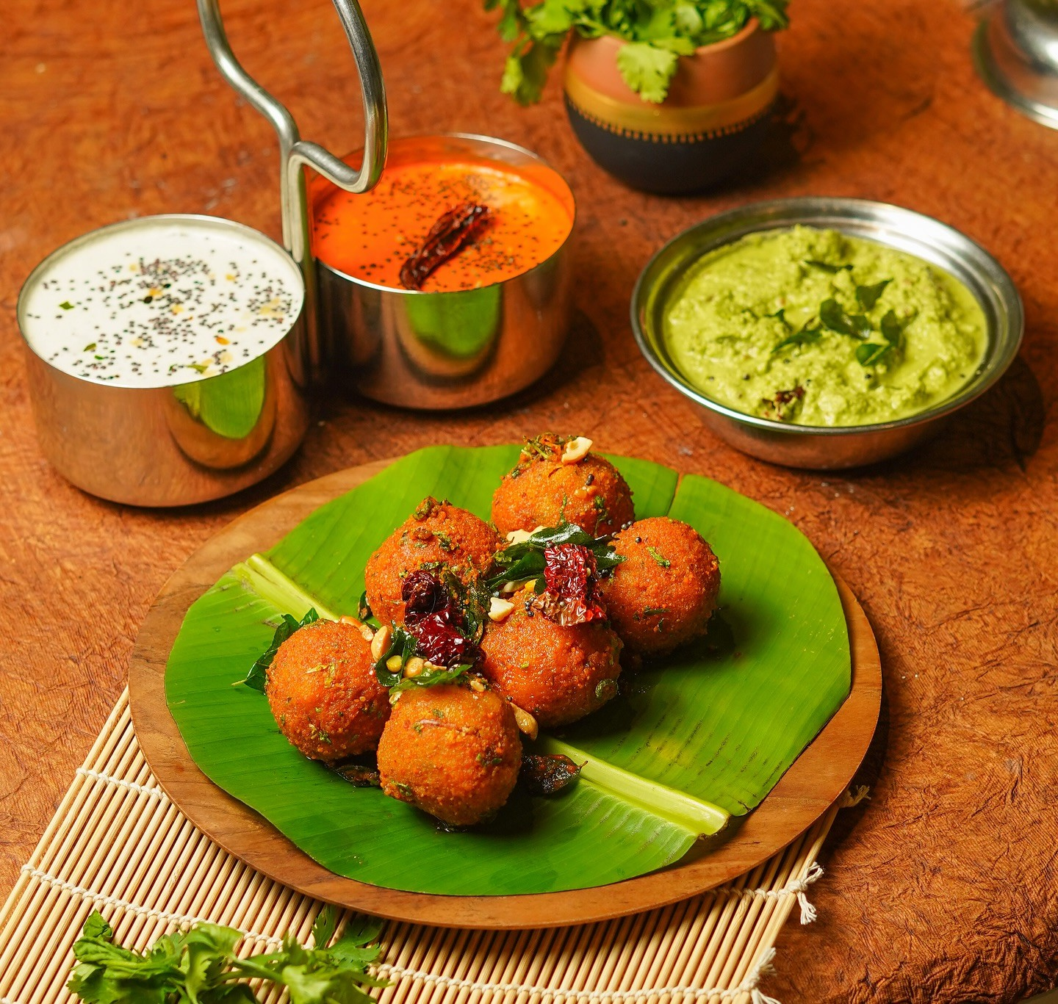
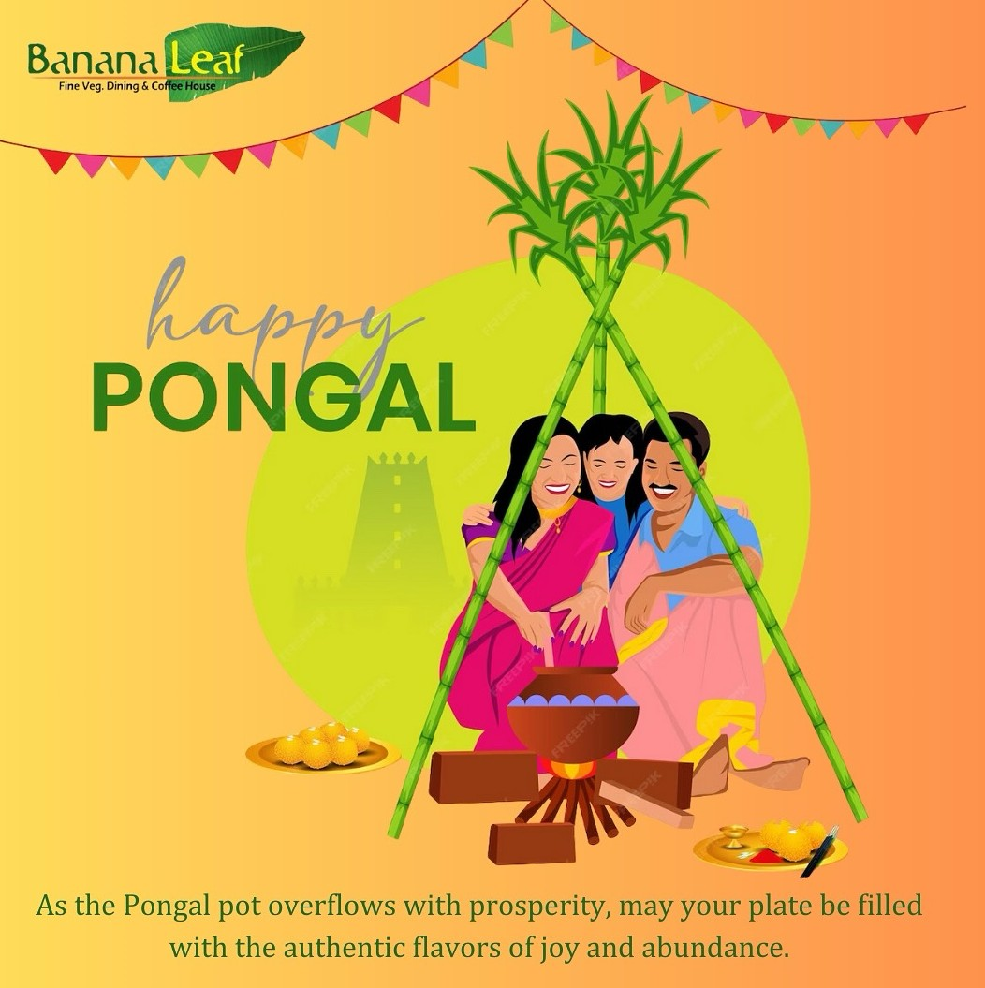
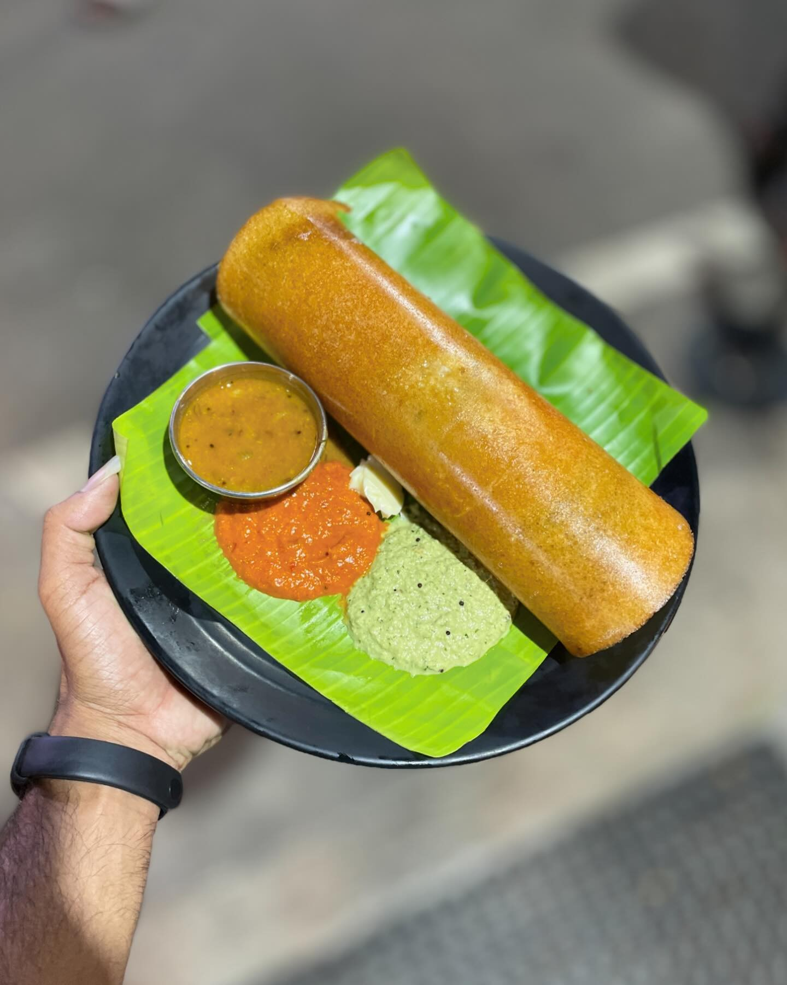
Phase 2:
1. Content Marketing:
Plan your content in advance by creating a content calendar outlining the types of posts you'll share, as well as the frequency and timing of your posts. Mix up your content with a variety of formats, including photos, videos, stories, and user-generated content.
BAUs Topicals
Hero Content

Slide 8
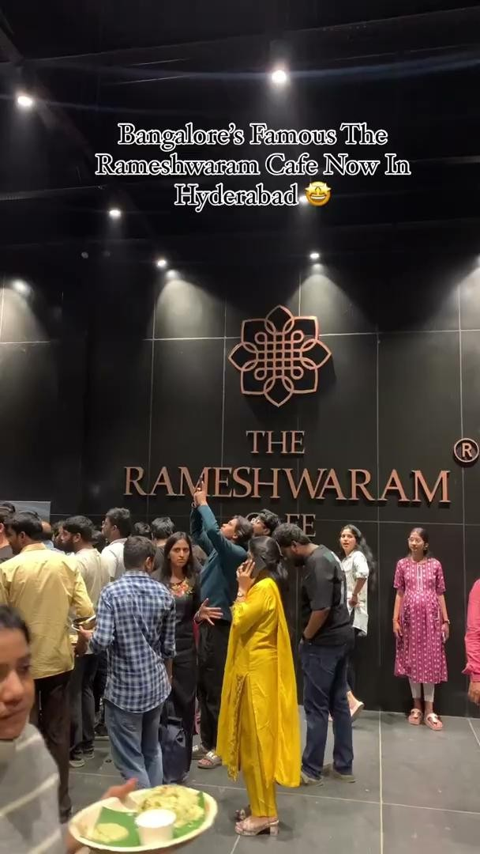
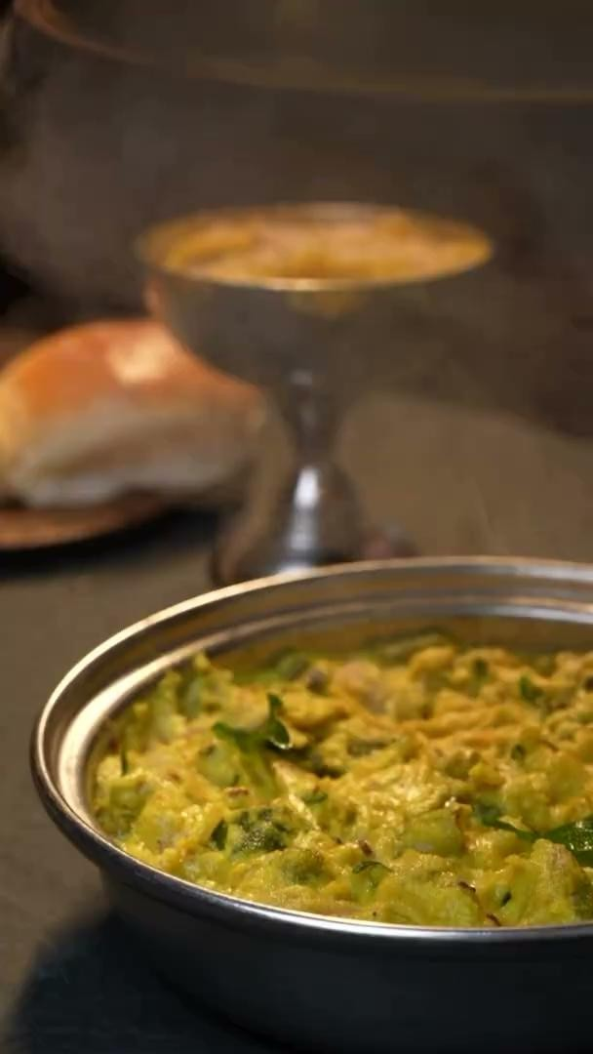
We can make this type of video for our New outlet For custom Outreach
https://www.instagram.com/p/C3HU0hMPV56/
Product Shoot
https://www.instagram.com/p/Cz3epeDRrpj/

Slide 9
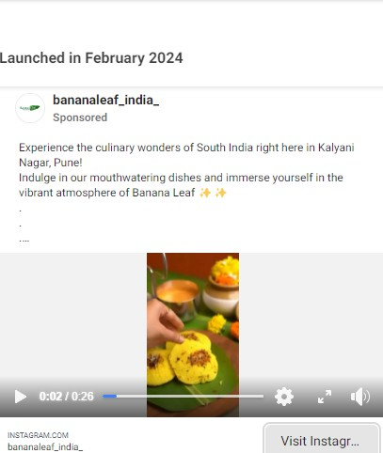
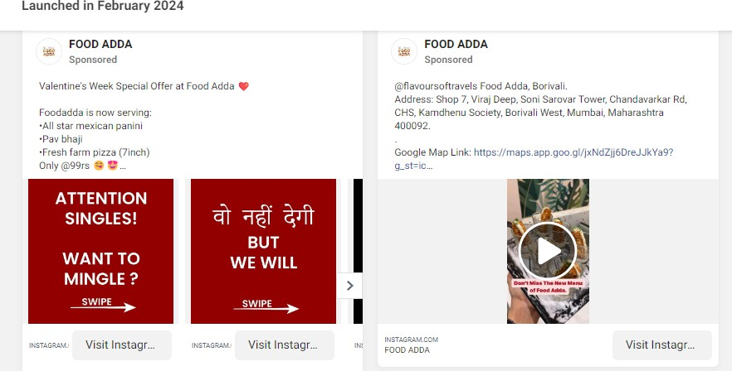
2. Performance Marketing:
Using Digital advertising platforms, such as Facebook Ads, Google Ads, or Instagram Ads, to reach potential customers who are likely to be interested in your restaurant

Slide 10
Phase 3:
1. Website:
A website provides a digital presence for your restaurant, making it easier for potential customers to find you online.
Customers can find essential information about your restaurant, such as your menu, hours of operation, location, contact details, reservation options, and special events.
A website enables you to showcase your menu in detail, including descriptions, pricing, dietary information, and high-quality images of your dishes.
Integrating an online reservation system into your website streamlines the booking process for customers, allowing them to make reservations conveniently from any device.
A well-designed website contributes to building your restaurant's brand identity and reputation.

Slide 11
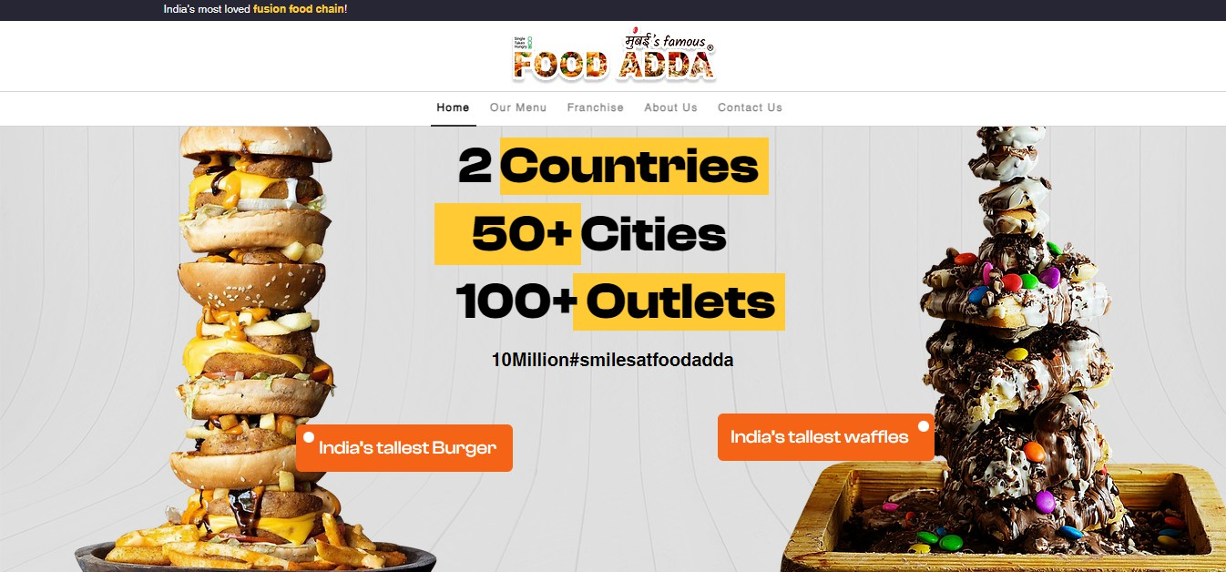
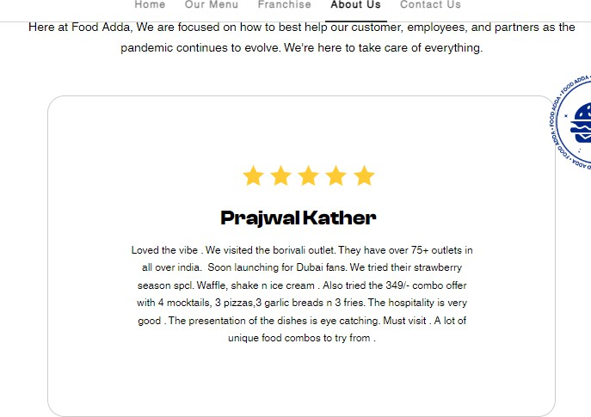
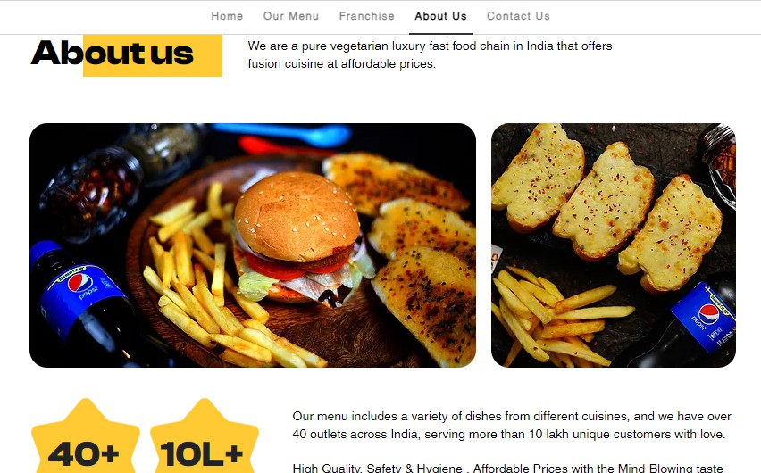
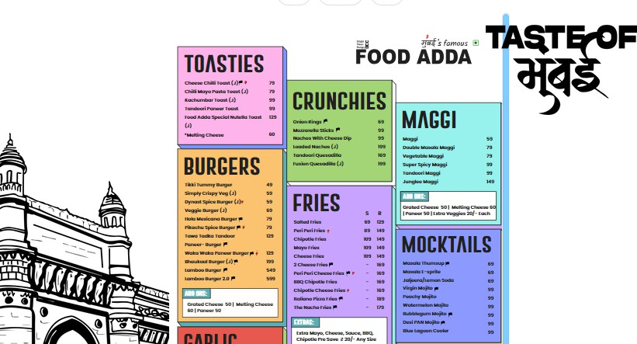

Slide 12
1. Google ads:
Google Ads allows your restaurant to appear at the top of search engine results pages (SERPs) when potential customers search for relevant keywords, such as "restaurants near me" or specific cuisines.
With Google Ads, you have control over your budget and bidding strategy, allowing you to set a maximum budget for your campaigns and pay only when users click on your ads
Google Ads provides detailed analytics and reporting tools that allow you to track the performance of your campaigns in real-time.
Google Ads supports a variety of ad formats, including text ads, display ads, and video ads, allowing you to choose the format that best suits your marketing goals and target audience.

Slide 13
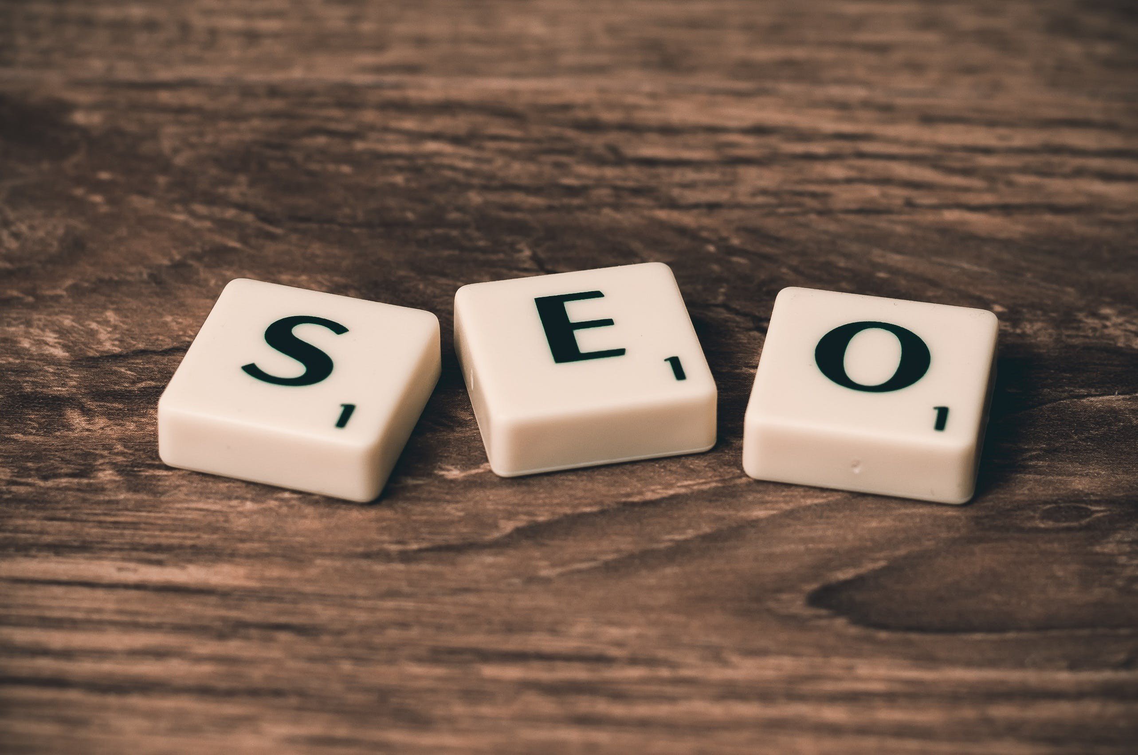
Phase 4:
SEO:
SEO helps your restaurant's website rank higher in search engine results pages (SERPs) when potential customers search for keywords related to your restaurant.
By optimising your website for relevant keywords and phrases, you can attract more organic traffic from search engines.
Unlike paid advertising, SEO is a cost-effective long-term strategy for driving traffic to your restaurant's website.
Websites that appear at the top of search engine results are often perceived as more trustworthy and credible by users. By optimising your website for SEO, you can improve its visibility and authority, building trust with potential customers and encouraging them to dine at your restaurant.

Slide 14
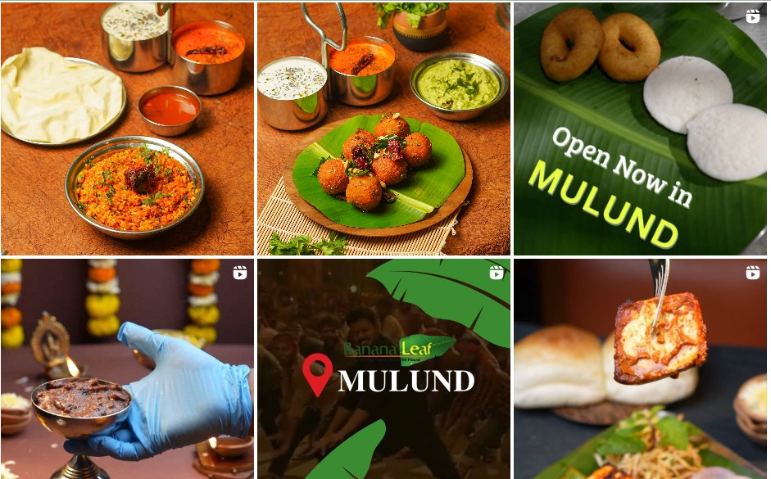
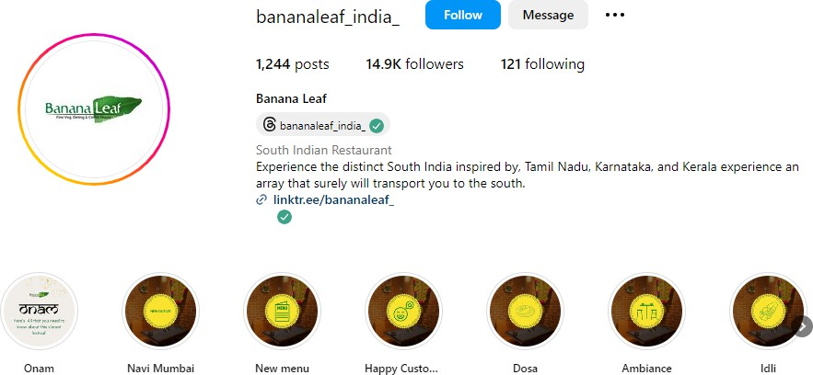
Competitors:
1. The Banana Leaf:

Slide 15
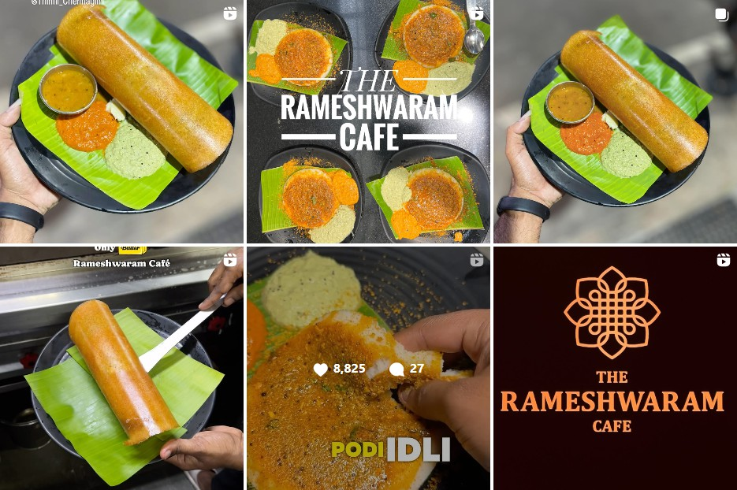
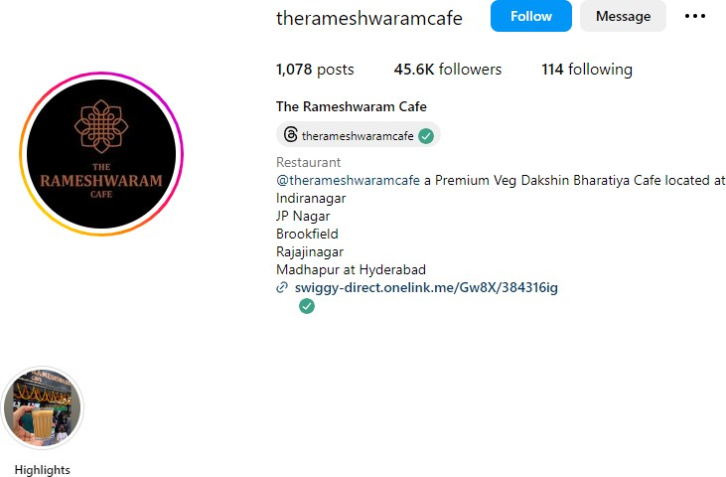
2. The Rameswaram cafe

Slide 16
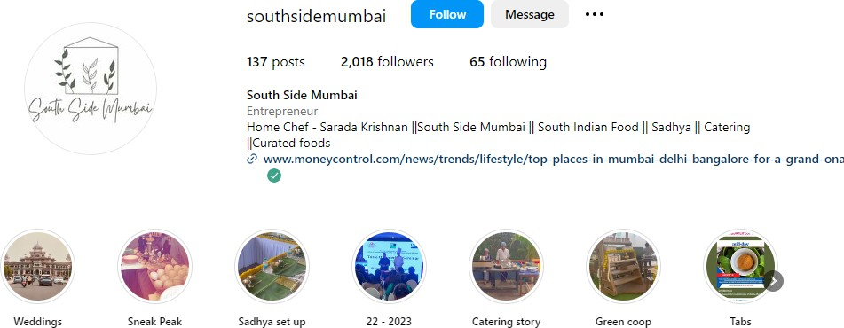
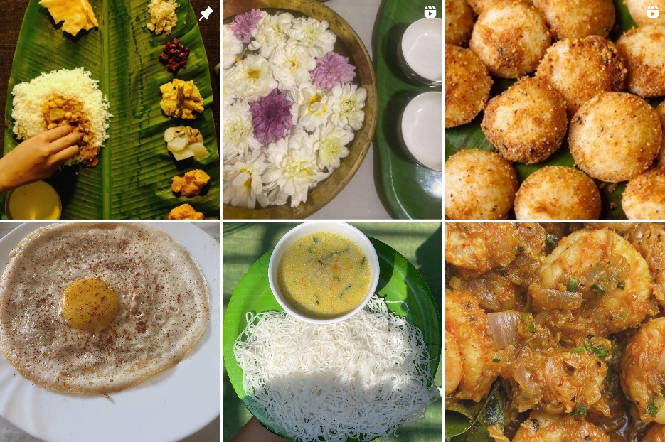
3. South Side Mumbai

Slide 17
Phase 1 Commercials:
12 to 15 Posts in total which will contain-
4-6 Influencer marketing
6-8 BAUs
2-3 Topicals(if any in that month)
Additional hero content if any required

